Slide 1

ADI x AuxoAI: ConverseWithData Discussion
April 2025

Slide 2
Agenda
CONVERSE WITH DATA OVERVIEW
EXECUTION PLAN
DELIVERY POD
DELIVERABLES
SUPPORT REQUIRED FROM ADI
2

Slide 3

Unified Self-Service through Multi-Agent Orchestration
Focus of this document
Unified Self-Service through Multi-Agent Orchestration
One conversation-driven platform uniting ingestion, transformation, governance, and analytics
No specialized technical skill required—speeding time-to-insight and empowering everyone to become data-savvy
Multi-Agent Orchestration
Converse With Data
Intelligent Data Ingestion Agent
Smart Transformation Agent
Intelligent Analytics Assistant Agent
Smart Health Monitor Agent
Smart Governance Agent
Enables users to query data using plain English via automatic SQL generation, execution and dashboards
Simplifies data access for non-technical users through text-to-SQL capabilities
Enables AI based data ingestion through NLU, source connectivity, schema detection, and ingestion scheduling
Integrates with Fivetran, etc for intelligent, context-aware data ingestion
Applies dbt-style transformations to prepare analytics-ready datasets
Integrates with dbt for smart modeling, performance tuning, and lineage tracking
Integrates with Dataiku and Snowflake to support self-service analytics
AI-based insights and text-to-SQL capabilities for ad-hoc analysis.
AI based platform monitoring, performance and data pipeline health
Interfaces with Datadog for real-time observability and alert
Ensure optimized performance and cost
Intelligent data cataloging, smart access control, and robust compliance automation
Leverages Atlan/ Immuta for intelligent data governance
Natural Language Portal
Users describe goals in plain English, and the portal’s AI intelligently interprets and orchestrates tasks across data services

Slide 4

Access to Data Without SQL:
Converse with Data Platform allows you to explore and analyze data directly, even without SQL expertise, empowering you to make informed decisions faster.
Independence in Data Queries:
Perform ad hoc data queries on your own, reducing dependence on IT for accessing and manipulating data.
Business stakeholders can converse directly with data, gaining actionable insights in real time.
How does it benefit the business?
Real-Time Insights:
Receive immediate responses to your data queries in plain language, enabling quicker responses to business needs and opportunities.
What is the total savings and spend for indirect materials across quarters?
What are the commodities with highest spend for indirect materials for Flash for FY24-Q2?
User-Friendly Interface:
Intuitive design and natural language processing make it easy for you to interact with complex data sets and derive meaningful insights.
Enhanced Productivity:
Spend less time waiting for data and more time leveraging insights to drive business outcomes.

Slide 5
MVP Scope
Future Scope
Capability View of the Architecture enabling ConverseWithData to interact with various sources through Data Virtualization
Business Personas
Analytics, AI & ML Engine
Sales Ops
Finance
Supply Chain
Sales Strategy & Planning
Procurements
Generative AI (Converse With Data)
Reports/Dashboards
Model Catalog
Consumption Layer
APIs
SQL
Data Self Serve
LLM Experience Layer – Text2SQL
AI/ML Feature Store
Gen AI Toolkit
(Prompt Templates, LLMs)
Gen AI Guardrails
(AI Fairness 360, Bias Checks)
Integration Layer
Access Control and Governance
Data Virtualization Layer
Enterprise Data Catalog
Data Sources
SQL Server
SAP
PostgreSQL
AWS S3
Snowflake
MySQL
Model N
Work Day
AWS Redshift
Azure Data lake

Slide 6
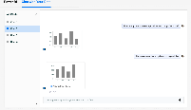
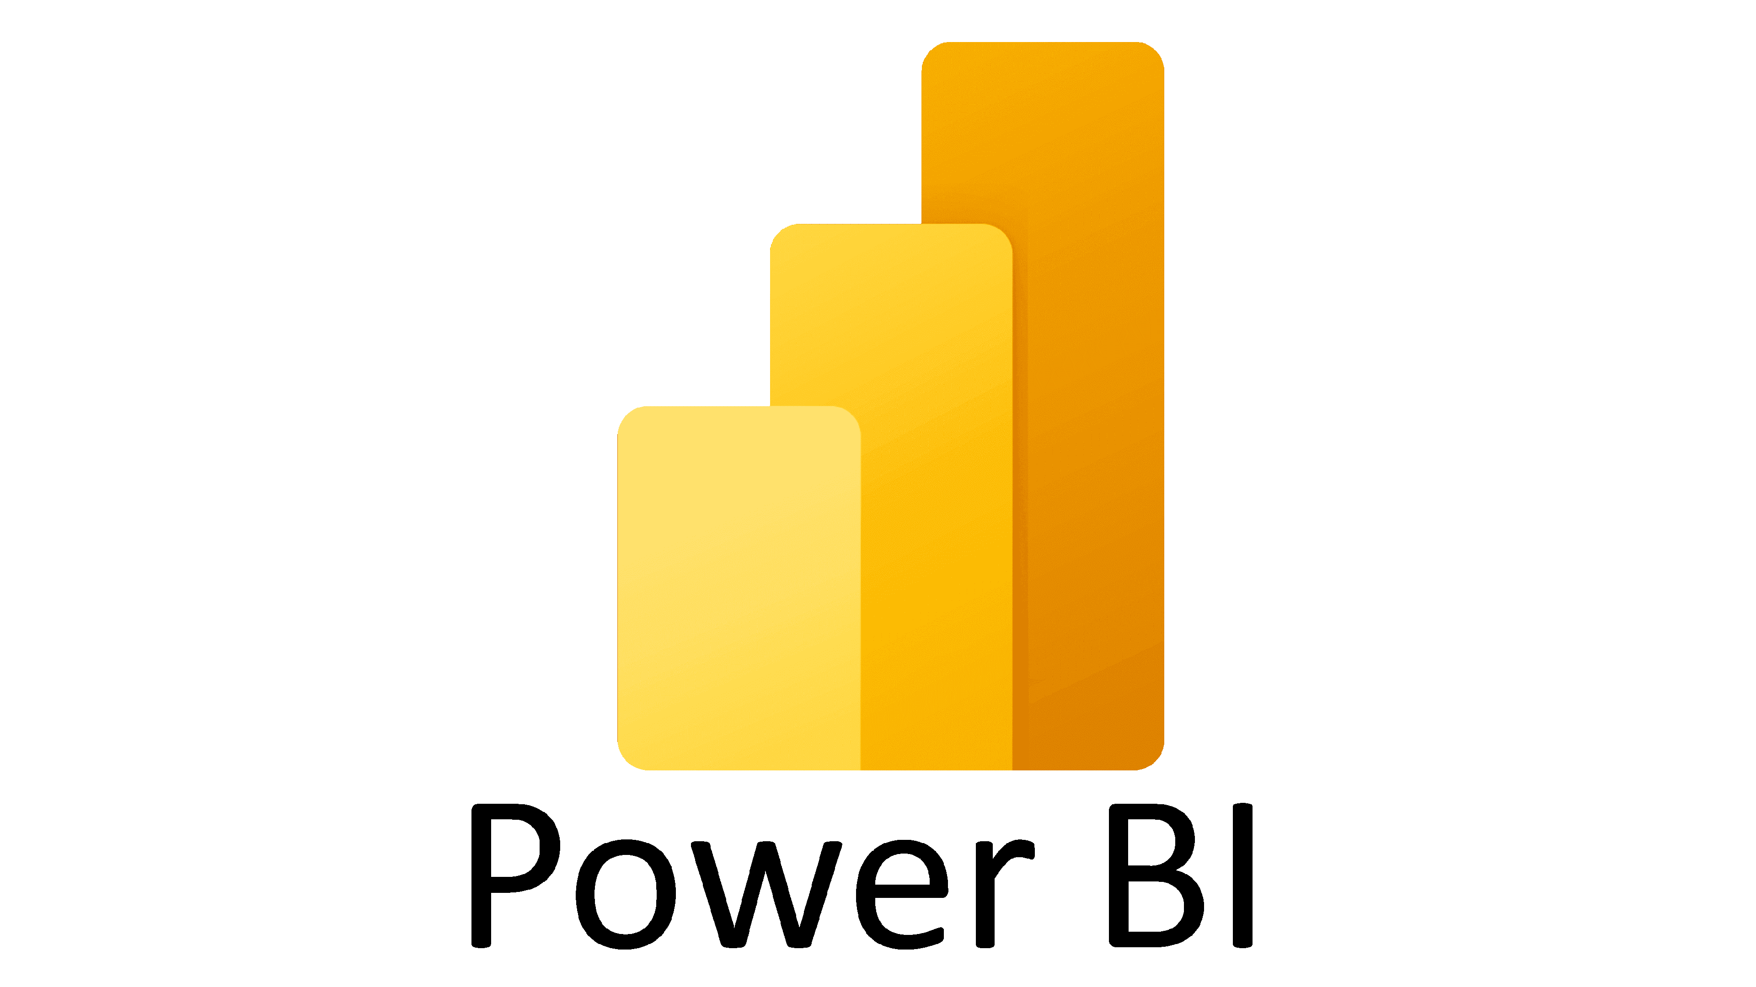


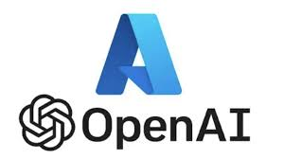





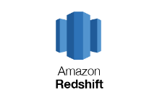
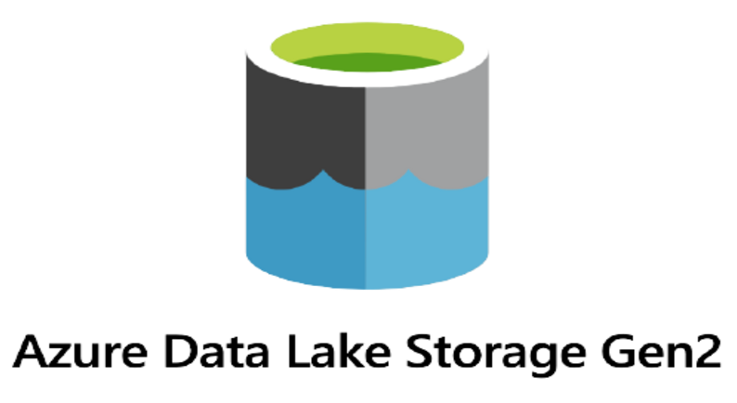
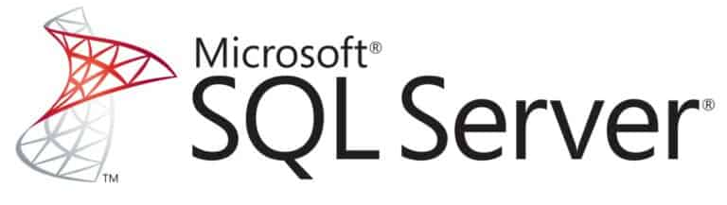






Component Architecture enabling ConverseWithData to interact with various sources through Data Virtualization
Business Personas
Analytics, AI & ML Engine
Sales Ops
Finance
Supply Chain
Sales Strategy & Planning
Procurements
Gen AI
Consumption Layer
Data
virtualization
Text2SQL
Azure Open AI
Elastic Vector Store
Integration Layer
Access Control and Governance
Data Virtualization Layer (Denodo DV)
Enterprise Data Catalog*(Atlan/Collibra)
API Gateway
Data Sources
Sales Ops
Finance
Supply Chain
Procurements
Sales Ops
Finance
Supply Chain
Procurements
Procurementscv
* Tech stack shown is indicative

Slide 7








ConverseWithData – Overall Process View
Data Catalog/
Table metadata
Fail
Application DB
2.1
User accessible table info
ConversewithData Engine
Vector store
1
Single Sign On
User query (Natural Language)
Data(RBAC)
Access Control Check
Fetch the Metadata, Data dictionary
User
3
User
Login
Authentication & Authorization
2
Permit
4
Metadata Info + User text
LLM
Response
(Data Sharing)
Gen AI based
Query Generation
Generate SQL Query
8
Text
Charts
Tech Stack
Data
sources
5
Data Catalog*/
Table metadata
Data Availability
7
React
Frontend
LLM Models
Fast API
Vector store
Curated Layer
Non-Curated Layer
Data Virtualization (Optional)
Optimized Query Execution
6
Query complexity check
AKS
Application DB
Microsoft
Entra ID
Azure Cache Redis
Notify on execution progress
*Tech stack shown is indicative

Slide 8
ConverseWithData – Detailed Flow
1
2
3
4
User Authentication
The user logs in via Single Sign‐On using Microsoft Entra ID
Upon successful authentication, the user’s identity and entitlements are established
User Prompt & Context Retrieval
User provides a natural language prompt in the chat interface
The application uses user’s identity to retrieve accessible datasets from the EDC, source system, or custom implementation
Metadata & Table Information
The application retrieves metadata and table info from the Enterprise Data Catalog (or the source system)
This ensures only authorized table metadata is visible to the LLM
Vector Store Lookup & LLM Query Generation
Relevant data dictionary and schema documentation are retrieved from the Vector DB (e.g., Elasticsearch)
The LLM (hosted via Azure OpenAI, etc.) takes the user prompt & metadata context to generate a SQL query
8
7
6
5
User Notification
The user is notified of the query execution progress, including any complexity warnings or partial data restrictions
Once complete, the final output is available for review or further conversation in the interface
Response Generation
The application compiles the query results, textual summaries, and any visualizations into the final response
The user sees the answer and charts in the chat interface
Query Execution
Final SQL query is executed either directly on the data source (e.g., SQL Server) or via a Federated Query / Data Virtualization Layer (e.g., Denodo)
Once the data is retrieved, it’s converted into a text/table or chart‐friendly format
Data Layer Checks
The system checks if user’s query targets Curated or Non-Curated Layer
Performs Query Complexity Check by parsing query and estimating execution cost using historical data and DB stats
Notifies users if query complexity exceeds defined thresholds and suggests efficient alternatives (e.g., pre‐curated data or simplified queries)

Slide 9
Execution Plan: Phase 1
# | Activity | 21-Apr | 28-Apr | 05-May | 12-May | 19-May | 26-May | 02-Jun | 09-Jun | 16-Jun | 23-Jun
1 | Architecture and Technical Design
2 | Setup and Env Access
3 | Data Discovery, Access and Profiling
4 | Model Selection and Prompt template design
5 | Multi agent creation and orchestration
6 | Deployment(API/UI)
7 | Setup App DB
8 | Setup Vector Store
9 | Semantic search and keyword extraction
 | User Feedback
 | SSO Integration
10 | Integration testing
11 | Refinements and optimization
12 | Testing and validation
13 | Demo
Notes:
Set up, data discover and landscaping, architecture, front end development, backend development, testing and demo

Slide 10
Execution Plan: Phase 1
# | Activity | 14-Apr | 21-Apr | 28-Apr | 05-May | 12-May | 19-May | 26-May | 02-Jun
1 | Architecture and Technical Design
2 | Setup and Env Access
3 | Data Discovery, Access and Profiling
4 | Model Selection and Prompt template design
5 | Multi agent creation and orchestration
6 | Deployment(API/UI)
7 | Setup App DB
8 | Setup Vector Store
9 | Semantic search and keyword extraction
10 | Integration testing
11 | Refinements and optimization
12 | Testing and validation
13 | Demo
Notes:
Set up, data discover and landscaping, architecture, front end development, backend development, testing and demo

Slide 11
Execution Plan: Phase 2
# | Activity | 09-Jun | 16-Jun | 23-Jun | 30-Jun | 07-Jul | 14-Jul | 21-Jul | 28-Jul
1 | Architecture Enhancements and Design
2 | Data Access and Profiling for complete use case
3 | Data setup and modelling
4 | Prompt template refinement and testing
5 | SSO integration
6 | Github and CICD integration
7 | User feedback
8 | Output results standardization and refinement
9 | Integration with Data catalog
10 | Integration with Data virtualization/ another db
11 | Standardizing the access controls
12 | Capturing Usage behaviour and duration stats
13 | Performance optimization and fine tuning
14 | Testing and Validation
15 | UAT

Slide 12


Delivery Pod Structure
AuxoAI Team
ADI Team
Scrum Lead
Platform Team
AI Engineer
Lead and Architect
Auxo Team
ADI Team
Back End Engineer
Data Engineer
Data Domain Teams
Data Infra SME
Front End Developer
QA Engineer

Slide 13
Phase 1 Deliverables
Architecture Design Document
MVP Converse with Data Application enabled for priority datasets within a domain–
Conversation interface
Ability to create new conversation
Ability to expand the responses
Ability to download the responses
Ability to store user history
Ability to leverage context from previous user questions
Ability to store user feedback
SSO Integration
* Based on broader tool alignment

Slide 14
Phase 2 Deliverables
Updated Architecture Design Document
Converse with Data Application enabled for the finalized domain with additional features–
Ability to store user feedback
Ability to copy prompts
SSO Integration
Performance Optimization
UAT Support
Roadshow Support
* Based on broader tool alignment

Slide 15
Support Required from ADI
Assign a Single Point of Contact (SPOC): To coordinate feedback, approvals, and cross-functional alignment.
Provide a Data Subject Matter Expert (SME): To support schema understanding, business context, and query validation.
Access to GenAI Infrastructure and Models: Ensure required compute resources and model endpoints are provisioned for development and testing.
Database Schema and Metadata Documentation: Share comprehensive schema details, data dictionaries, and entity relationships for accurate SQL generation.
Data Preparation and Access: Provide access to relevant databases (dev/test environments), sanitized sample data, and connection credentials.
User Scenarios and Sample Queries: Share representative user questions and corresponding SQL outputs to guide model fine-tuning and evaluation.

Slide 16
Thank You!

Slide 17
Appendix

Slide 18
Commercials
Phase | Cost
Phase 1 (14 Apr’25 to 06 Jun’25) | $100,000
Phase 2 (09 Jun’25 to 01 Sep’25) | $105,000
Total | $205,000

Slide 19
Budget Calculation
Total SOWs from mid March to end April | $ 314,600
Old adjustment (on Auxo) | $ 14,000
Total Kitty | $ 328,600
Actual Burn till date | $ 85,250
Discount during march time | $ 3,950
Remaining | $ 2,39,400
UDA Burn Projected till week of June 2nd | $ 17,400
Product Manager Projected for 9 weeks | $ 72,000
Remaining amount for other services | $ 1,50,000

Slide 20
Our Common Information Model for Finance
General Ledger
Financial Reporting
Period Closure
GL Accounts
GL Account Balance
Journal Entries
Accounting Document
GL Account Balance
Accounts Receivable
Customer Invoicing
Payments
Customer Master
Customer Invoices
Customer Payments
Customer Credit Limits
Credit Management
Domain 1
Financial Accounting
Accounts Payable
Vendor invoicing
Payments
Vendor Master
Vendor Invoices
Vendor Payments
Payment Terms
Payment terms
Asset Accounting
Fixed Assets
Depreciation
Asset Master
Asset Transactions
Depreciation Rules
Depreciation Postings
Asset Transactions
Bank Accounting
Bank transactions
Cash management
Bank master data
Bank Transactions
Bank Statements
Cash Position
Bank reconciliation
Notes:
Connected Insights:
Enhance decision-making agility at both functional and enterprise levels by leveraging real-time data and cross-functional insights.
Connected Systems:
Unified enterprise view with foundational systems integrated with functional tools
Seamless process orchestration by establishing a robust Data & AI foundation enabling real-time analytics and predictive AI/ML
Data Quality, Security and Traceability by Implementing governance (DV, MDM, DQ, RBAC)
Data Quality, Security and Traceability by Implementing governance (DV, MDM, DQ, RBAC)
Connected Experience:
Deliver personalized customer journeys, seamless employee experiences, and real-time supply chain visibility
Ensure ease of use with integrated, user-friendly interfaces and 24/7 availability through AI-driven tools like SimiliQ for instant support and insights.

Slide 21



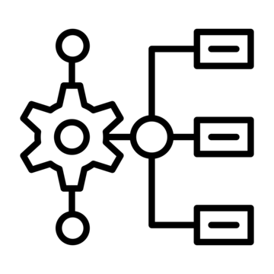

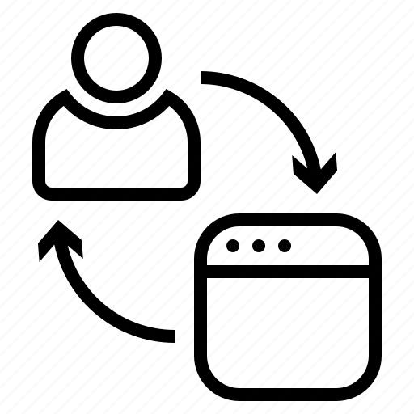
Technical Implementation Architecture
Vector Knowledge Store
NLP Engine
API Integration Layer
Workflow Engine
Monitoring & Analytics
Agent Communication Bus
Embeddings of Fivetran documentation, API references, and best practices
Semantic search capabilities for rapid knowledge retrieval
Regular update mechanism to stay current with Fivetran releases
Fine-tuned LLM for data integration domain
Specialized models for technical parameter extraction and validation
Few-shot learning capabilities for adapting to organization-specific terminology
Authentication and authorization management
Rate limiting and request optimization
Response caching and connection pooling
Error handling and retry logic
State management for multi-step ingestion processes
Parallel execution of independent tasks
Checkpoint and recovery mechanisms
Long-running operation management
Real-time metrics collection from Fivetran APIs
Performance benchmarking against historical data
Predictive analytics for resource planning
Anomaly detection for early issue identification
Event-driven architecture for inter-agent communication
Standardized message formats for agent interoperability
Prioritization mechanisms for urgent notifications
Audit logging of all inter-agent interactions

Slide 22




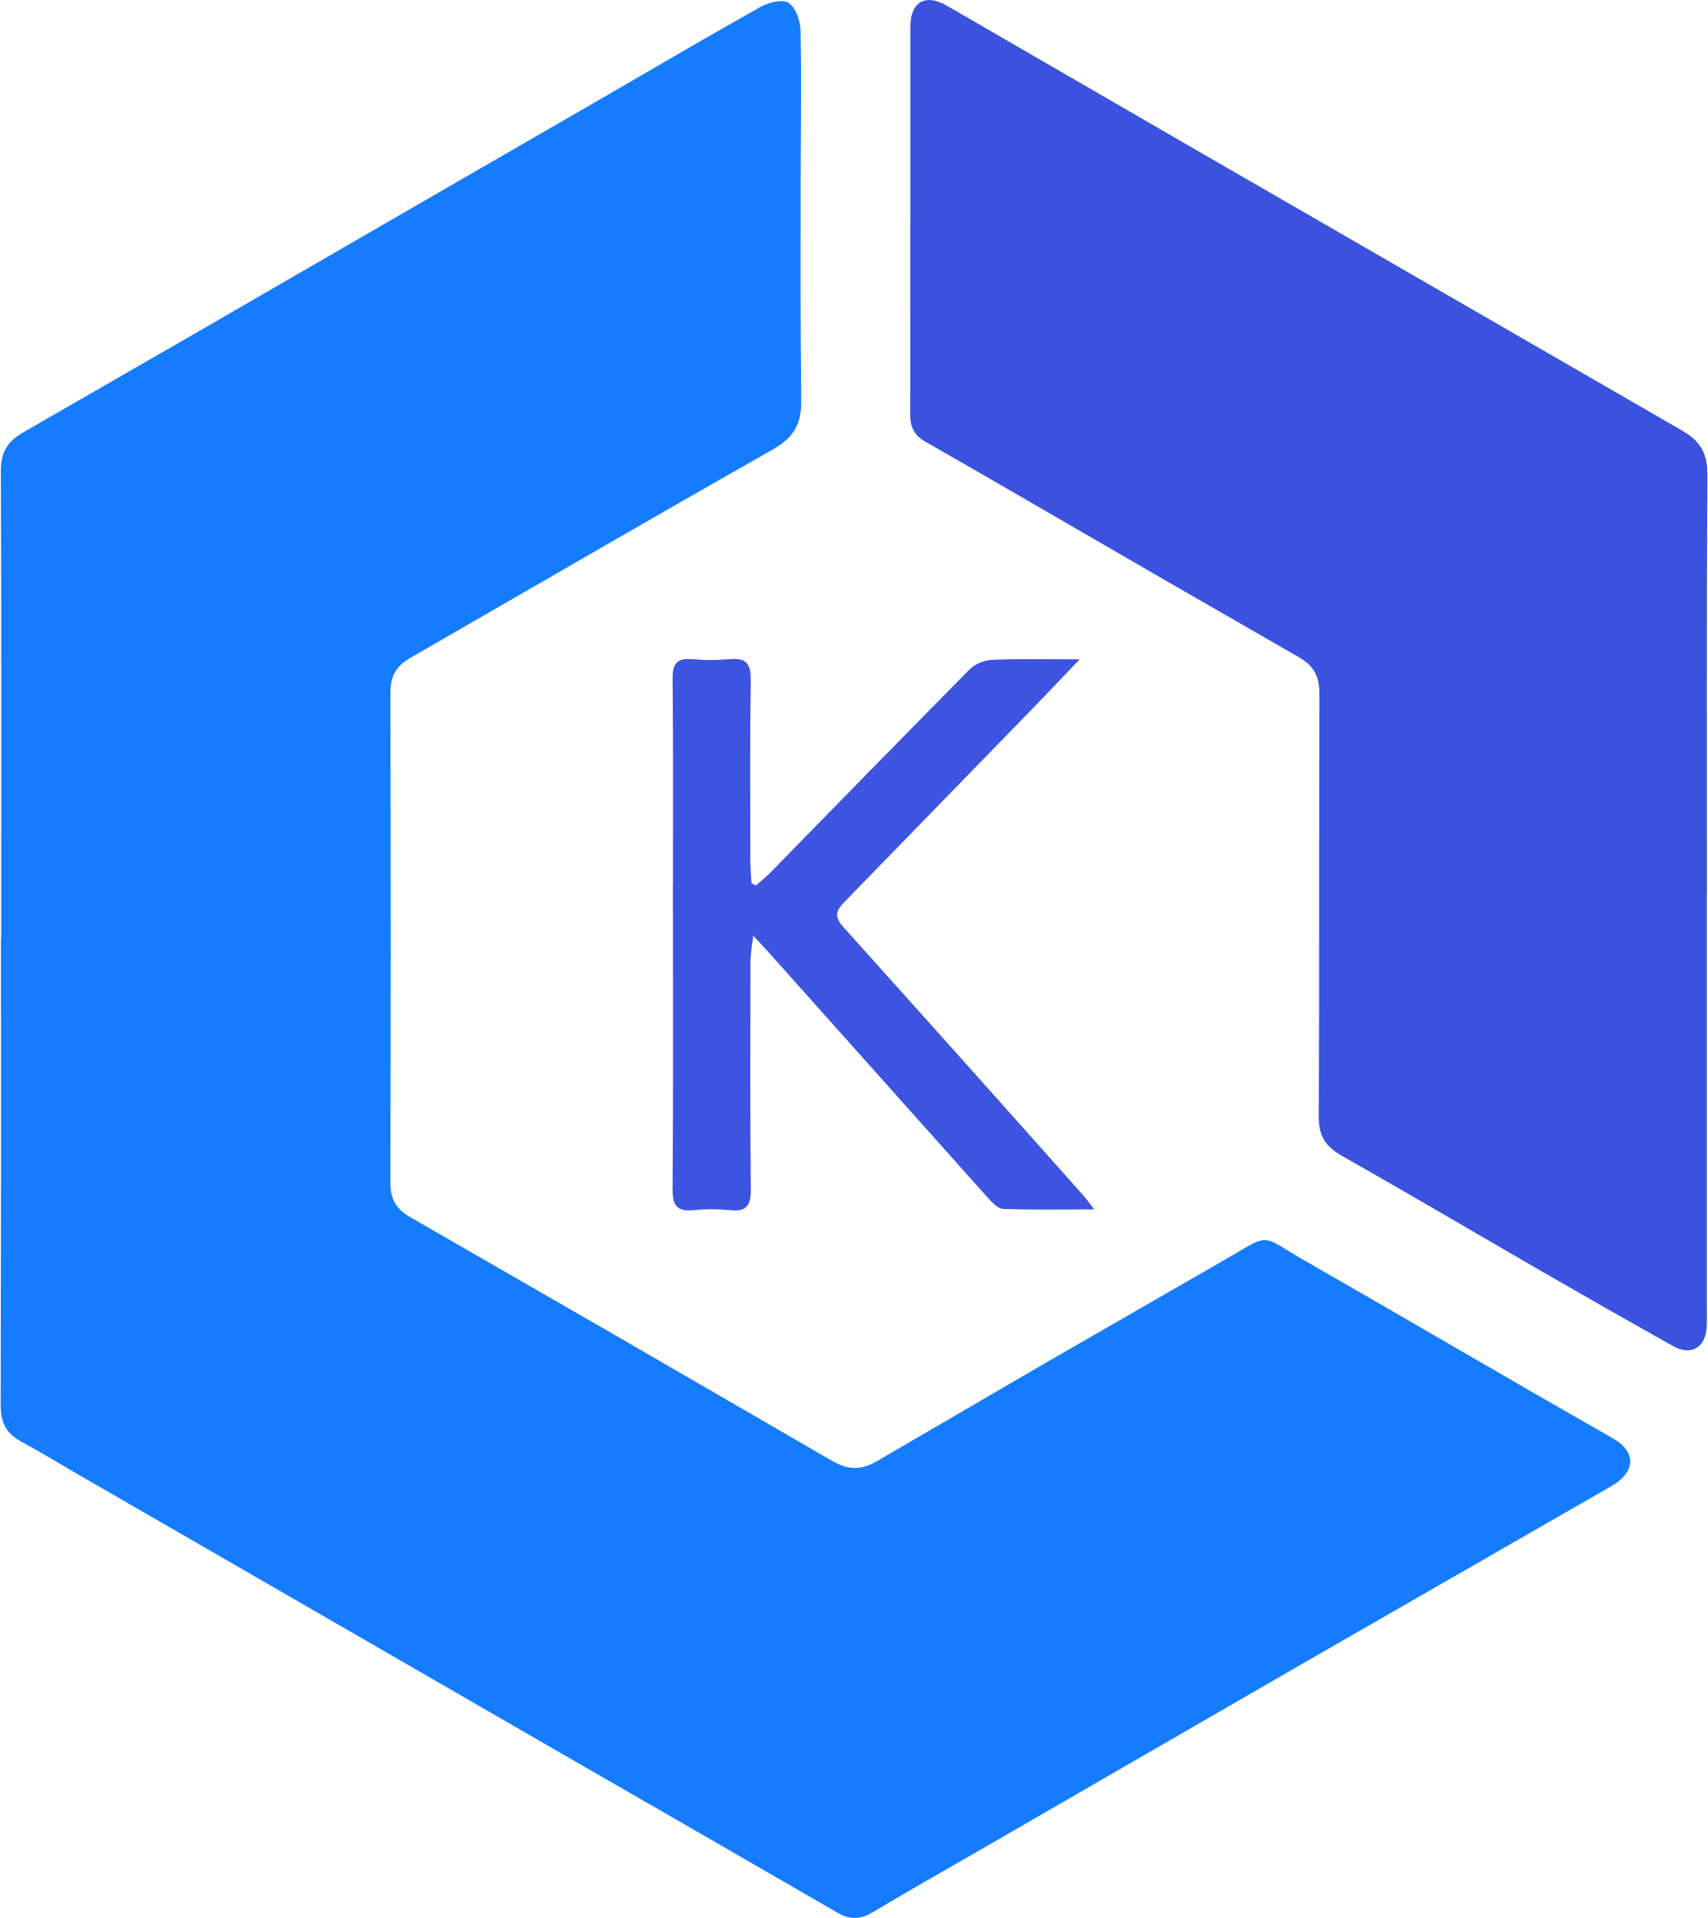






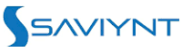





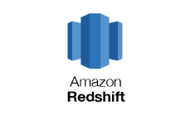

Gen AI Architecture Component View : Self Serve with ConverseWithData Selection can be refined based on discussion with ADI Arch. team
Metadata Ingestion/Fetch
Generative AI (NLP on Procurement Data)
Bedrock
Enterprise Data Catalog (Options)
App metrics DB
AWS CloudWatch
AWS Elastic Kubernetes Services
User selects the tables for generating Metadata information
Bedrock
8
10
1
Backend
2
3
5
Admin
Content Management UI
11
4
Metadata generation lambda
AI generated Metadata information
Metadata Ingestion and Fetch lambda
6
User
Fast API
7
Admin reviews generated Metadata information
Application Lambda
Frontend UI
9
Data Virtualization Layer
AWS Sagemaker Notebook Instance
PG Vector Store
For this MVP, AWS Sagemaker Notebook will be used for Ingestion
EDW
Data lake
Redshift
*Components highlighted in green are already implemented
Notes:
Flow
Admin selects the tables for generating metadata information and is authenticated using SSO. Metadata generation lambda fetches the table metadata information including user permissions and data dictionary from enterprise data catalog
In case data dictionary is not available or is partially available, Metadata generation lambda will trigger bedrock and generate complete metadata
Admin can also review/correct the LLM generated information from the UI
Metadata Ingestion Lambda ingests information to AWS RDS
Application Lambda using the AWS RDS as vector database to check if the user has access to data
Check if the query is available in the cache and can be reused
In case query is not present in cache, Application Lambda connects to LLM from Bedrock for generating SQL query using the table metadata information, using optimizations like index/partitions/etc.
Execute the generated SQL statement on data virtualization layer integrated with Saviynt
Store User history, Feedback, Performance metrics in Aurora Pg DB
Backend sending responses to frontend

Slide 23
MVP Scope
Future Scope
Capability View of the Architecture enabling ConverseWithData to interact with various sources through Data Virtualization
Business Personas
Analytics, AI & ML Engine
Sales Ops
Finance
Supply Chain
Sales Strategy & Planning
Procurements
Generative AI (Converse With Data)
Reports/Dashboards
Model Catalog
Business Personas
Analytics, AI & ML Engine
Sales Ops
Finance
Supply Chain
Sales Strategy & Planning
Procurements
Generative AI (Converse With Data)
Reports/Dashboards
Model Catalog
Consumption Layer
Consumption Layer
APIs
SQL
Data Self Serve
LLM Experience Layer – Text2SQL
AI/ML Feature Store
Gen AI Toolkit
(Prompt Templates, LLMs)
Gen AI Guardrails
(AI Fairness 360, Bias Checks)
APIs
SQL
Data Self Serve
LLM Experience Layer – Text2SQL
AI/ML Feature Store
Gen AI Toolkit
(Prompt Templates, LLMs)
Gen AI Guardrails
(AI Fairness 360, Bias Checks)
Integration Layer
Access Control and Governance
( Azure AD/ Entra ID )
Data Virtualization Layer
(Denodo DV)
Enterprise Data Catalog
(Atlan/Collibra)
Integration Layer
Access Control and Governance
( Azure AD/ Entra ID )
Data Virtualization Layer
(Denodo DV)
Enterprise Data Catalog
(Atlan/Collibra)
Data
Sources
SQL Server
SAP
PostgreSQL
AWS S3
Snowflake
Data Sources
MySQL
Model N
Work Day
AWS Redshift
Azure Data lake
SQL Server
SAP
PostgreSQL
AWS S3
Snowflake
MySQL
Model N
Work Day
AWS Redshift
Azure Data lake

Slide 24
MVP Scope
Future Scope
Capability View of the Architecture enabling ConverseWithData to interact with various sources through Data Virtualization
Business Personas
Analytics, AI & ML Engine
Sales Ops
Finance
Supply Chain
Sales Strategy & Planning
Procurements
Generative AI (Converse With Data)
Reports/Dashboards
Model Catalog
Consumption Layer
APIs
SQL
Data Self Serve
LLM Experience Layer – Text2SQL
AI/ML Feature Store
Gen AI Toolkit
(Prompt Templates, LLMs)
Gen AI Guardrails
(AI Fairness 360, Bias Checks)
Integration Layer
Access Control and Governance
( Azure AD/ Entra ID )
Data Virtualization Layer
(Denodo DV)
Enterprise Data Catalog
(Atlan/Collibra)
Data
Sources
SQL Server
SAP
PostgreSQL
AWS S3
Snowflake
MySQL
Model N
Work Day
AWS Redshift
Azure Data lake
24
@2024 AuxoAI – Confidential and Proprietary

Slide 25
Component Architecture enabling ConverseWithData to interact with various sources through Data Virtualization
Business Personas
Analytics, AI & ML Engine
Sales Ops
Finance
Supply Chain
Sales Strategy & Planning
Procurements
Gen AI
Consumption Layer
Data virtualization
Text2SQL
Azure Open AI
Elastic Vector Store
Integration Layer
Access Control and Governance
Data Virtualization Layer
Enterprise Data Catalog
API Management
Data
Sources
25
@2024 AuxoAI – Confidential and Proprietary

Slide 26
Implementation Timeline
Phase 1
Phase 2
Phase 3
1.5 months
2 months
1 month
Establish core knowledge base for Fivetran capabilities
Implement basic NLU for ingestion requests
Create fundamental API integration framework
AI based Relationship insights of Source data model
Implement support for top 10-15 most common connectors
Develop basic schema mapping recommendations
Create initial monitoring and reporting capabilities
AI based build for custom connectors using SDK and API
Test with real user scenarios
Refine NLU capabilities based on test results
Non-Fivetran Data movement over FTP to a target data model
Implement basic error handling and recovery
Objectives
Vector database of Fivetran connector documentation
Basic intent classification model
Core API integration layer with authentication
Entity relationship between data assets in the source
Functional connector setup and configuration
Basic schema mapping functionality
Simple monitoring dashboard
Validated agent for production use
Support FTP sources
Initial user documentation
Simple training module for citizen users
Deliverables

Slide 27
Phase 2 Deliverables
1. Updated Architecture & Scaling Blueprint
- Refine and expand system architecture for higher performance and scalability.
2. Integrated Data Pipeline
- Automate data transformation.
3. Refined Prompt Library
- Enhance prompt templates for improved LLM accuracy and context handling.
4. SSO Integration
- Implement single sign‐on with Microsoft Entra ID (Azure AD) for a seamless user experience.
5. GitHub & CI/CD
- Set up source control, automated builds, and deployments.
6. Data Catalog & Data Virtualization Integration
- Incorporate Enterprise Data Catalog* and Denodo* for Data virtualization federated queries.
7. Usage statistics & metrics
- Capture usage statistics and metrics for better insights and adoption.
8. Access Control Enablements
- Enforce role‐based security and table/column‐level permissions.
9. Performance Optimization
- Tune query execution plans and vector searches to reduce latency.
10. QA Validation & UAT Feedback
- Conduct thorough testing and gather user acceptance feedback for final refinements.
* Based on broader tool alignment

Slide 28
Phase 1 Deliverables
1. Architecture & Environment Setup
- Establish core infrastructure and environment prerequisites.
2. Data Connectivity & Profiling
- Connect to SQL Server and perform basic data exploration.
3. Integration with SQL Server
- Set up secure read access and test queries.
4. Prompt & Model Framework
- Develop the foundational logic for natural language to SQL conversion.
5. UI & API Deployment
- Launch the initial user interface and backend service endpoints (via FastAPI/React).
6. Vector Store & Application DB Layer
- Configure vector database (Elastic ) and the primary application database.
7. End‐to‐End MVP
- Deliver a working minimal viable product demonstrating the basic query flow.
* Based on broader tool alignment

Slide 29
Execution Plan – Phase 1
Week | Activity
Week 1 | Architecture finalization & data flow design
 | Break down into backend, AI, FE modules
Week 2 | Setup PoC Azure environment + repos
 | Create base backend & frontend code
 | Setup DB schema (App DB)
Week 3 | Populate Fivetran ingestion knowledge base
 | Setup & test vector DB
 | Design table relationship model from catalog
Week 4 | Integrate Fivetran API
 | Define NLU intent classes + GenAI prompt templates
Week 5 | Implement GenAI call to extract metadata from a sample source
 | API + vector retrieval integration
 | Connect FE to ingestion API
Week 6 | Integration testing
 | Internal dry-run of ingestion flow
 | Phase 1 demo & documentation

Slide 30
Execution Plan – Phase 2
Week | Activity
Week 7-8 | Add support for top 10 Fivetran connectors
 | Design tables mapping prompt/template
Week 9-10 | Integrate tables mapping output into FE
 | Logging of job status/errors
 | SSO Integration
Week 11-12 | Build GenAI-assisted flow to auto-generate Fivetran SDK-based connector
 | Add Fallback Error Messaging
Week 13 | Internal testing of 10 connector flows
 | Monitoring Dashboard UX
Week 14 | QA testing + dry run
 | UI/UX Refinements
Week 15 | Feedback incorporation
 | Final round of deployment tests
 | Phase 2 wrap-up demo & documentation

Slide 31
Our Common Information Model for Finance
General Ledger
Financial Reporting
Period Closure
GL Accounts
GL Account Balance
Journal Entries
Accounting Document
GL Account Balance
Accounts Receivable
Customer Invoicing
Payments
Customer Master
Customer Invoices
Customer Payments
Customer Credit Limits
Credit Management
Domain 1
Financial Accounting
Accounts Payable
Vendor invoicing
Payments
Vendor Master
Vendor Invoices
Vendor Payments
Payment Terms
Payment terms
Asset Accounting
Fixed Assets
Depreciation
Asset Master
Asset Transactions
Depreciation Rules
Depreciation Postings
Asset Transactions
Bank Accounting
Bank transactions
Cash management
Bank master data
Bank Transactions
Bank Statements
Cash Position
Bank reconciliation
Notes:
Connected Insights:
Enhance decision-making agility at both functional and enterprise levels by leveraging real-time data and cross-functional insights.
Connected Systems:
Unified enterprise view with foundational systems integrated with functional tools
Seamless process orchestration by establishing a robust Data & AI foundation enabling real-time analytics and predictive AI/ML
Data Quality, Security and Traceability by Implementing governance (DV, MDM, DQ, RBAC)
Data Quality, Security and Traceability by Implementing governance (DV, MDM, DQ, RBAC)
Connected Experience:
Deliver personalized customer journeys, seamless employee experiences, and real-time supply chain visibility
Ensure ease of use with integrated, user-friendly interfaces and 24/7 availability through AI-driven tools like SimiliQ for instant support and insights.

Slide 32
ConverseWithData – Detailed Flow
ConverseWithData – Detailed Flow
User Authentication
The user logs in via Single Sign‐On using Microsoft Entra ID.
Upon successful authentication, the user’s identity and entitlements are established.
User Prompt & Context Retrieval
The user provides a natural language prompt in the chat interface.
(2.1) The application uses the user’s identity to fetch the list of datasets (tables) they have access to, from the EDC or Source system or Custom implementation
If the user has no accessible datasets, an error is returned immediately.
Metadata & Table Information
The application retrieves metadata and table info from the Enterprise Data Catalog (or the source system) for the tables the user has access to.
This ensures only authorized table metadata is visible to the LLM.
Vector Store Lookup & LLM Query Generation
Relevant data dictionary and schema documentation are retrieved from the Vector Database (e.g., Elasticsearch).
The LLM (hosted via Azure OpenAI, etc.) takes the user prompt + metadata context and generates a SQL query.
Data Layer Checks
The system checks if the data for the user’s query resides in the Curated Layer or Non‐Curated Layer.
A Query Complexity Check is performed:
The query is parsed, and execution cost is estimated using historical data & DB stats.
If it exceeds predefined complexity thresholds, the user is notified and offered more efficient alternatives (e.g., pre‐curated data or a simplified query).
Query Execution
The final SQL query is executed either directly on the data source (e.g., SQL Server) or via a Federated Query / Data Virtualization Layer (e.g., Denodo).
Once the data is retrieved, it’s converted into a text/table or chart‐friendly format.
Response Generation
The application compiles the query results, textual summaries, and any visualizations into the final response.
The user sees the answer and (optionally) charts directly in the chat interface.
User Notification
The user is notified of the query execution progress, including any complexity warnings or partial data restrictions.
Once complete, the final output is available for review or further conversation in the interface.

